Slide 1

SAP HANA Cloud Multi-Model
Graph, Spatial
Q2/2022

Slide 2

Agenda
SAP HANA Cloud Smart Multi-Model
SAP HANA Spatial
SAP HANA Graph
Coding Challenge
©2022 SAP SE or an SAP affiliate company. All rights reserved. ǀ
PUBLIC

Slide 3
































SAP HANA Smart Multi-Model Unified Data Management and Processing
Single unified multi-model database that stores processes and analyzes multiple types of data
Real-time advanced analytics on any type of data while simultaneously processing transactions
Superior synergy with SAP applications and ability to operationalize ML across data types
Faster results with best-in-class algorithms and open standards in the cloud, on-premises, or hybrid
APPLICATION DEVELOPMENT
SMART MULTIMODEL PROCESSING
DATA VIRTUALIZATION
Application Runtimes
Language Choice
Spatial
Graph
Series
Data
Document Store
Replication
Caching
Data Quality
SAP UI5
Application Lifecycle
Management
Information
Modeling
Search &
Text Analysis
Streaming
Analytics
Predictive
Modeling
Machine
Learning
Federation
Integration
DATABASE MANAGEMENT
Columnar Store
Multi-Core &
Parallelization
Advanced
Compression
Multi-tenancy
Multi-Tier
Storage
Data
Modeling
Relational
Data Privacy
Admin & Security
High Availability &
Disaster Recovery
Notes:
SAP HANA is the solution from SAP.
It has been architected from day one to provide best-in-class unified data management for different data types – AKA multimodel data management - so you can use all your data to innovate without boundaries.
Let’s look at the unique characteristics of this offering.
Harness the value of all types of data​: Breadth of data types support in one solution
Gain instant situational awareness​: Analytics performance to join and correlate multiple data types at once (in context) and in real-time to deliver full situational awareness. Plus, it can process transactional workloads at the same time – so you get analytics on fresh data
Enhance business processes: Since HANA also runs your business applications, you can bring the intelligence extracted from all your data into your business processes – not just for operational analysis but also to power intelligent automation and advanced analytics with ML.
Democratize innovation​: All of this is complemented by built-in content – such as best in class, optimized algorithms - standard interfaces and languages support, and complete deployment flexibility - from on-prem to all major public clouds. So it becomes easier for you to leverage data for innovation

Slide 4
SAP HANA Cloud Multi-Model Core and Context
SAP HANA Cloud Spatial
Spatial datatypes and reference systems
Spatial functions, predicates, and algorithms
Esri and open source GIS integration
SAP HANA Cloud Graph
Expose your data as a network
Pattern matching queries
Custom network processing and algorithms
SAP HANA Cloud Document Store
Native store for JSON documents
Schema flexibility
JSON operations via SQL
Application
Domain clients
Business Apps
SQL queries and procedures
Algos
analytics, predictive, spatial, graph, search, relational
Developer
ML Python API
Data Scientist
Models
Tables
Documents
Multi-Model Data Integration
Data Integrator

Slide 5






SAP HANA Cloud Multi-Model Spatial Core Capabilities
Spatial data types
Natively store vector data types
points, lines, polygons…
Embedded in a 2 dimensional surface
Associated with a spatial reference system
Spatial function and predicates
Boolean operations, e.g. union, intersect
Relationship determination, e.g. contains, touches
Property computation, e.g. length, area
Transformation and inspection, e.g. SRS, lin. referencing
Consumption and ecosystem
SQL, ABAP
Esri ArcGIS, Esri geodatabase, GeoTools/GeoServer, QGIS
Python client for machine learning (hana-ml)
Roadmap milestones
Vector tiles
GIS integration
Python Environment
Python ML API
Applications
Augmented Processes
Spatial
Data Types
Routing
Data
Reference Systems
Coordinates
Spatial Optimization
SAP HANA

Slide 6
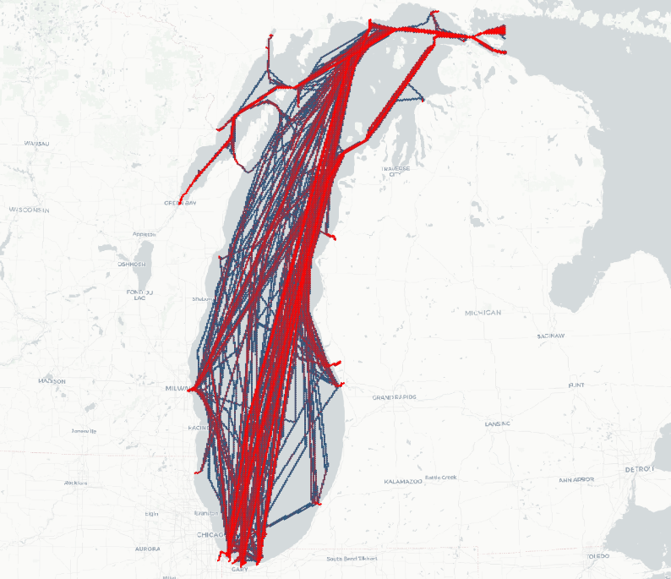
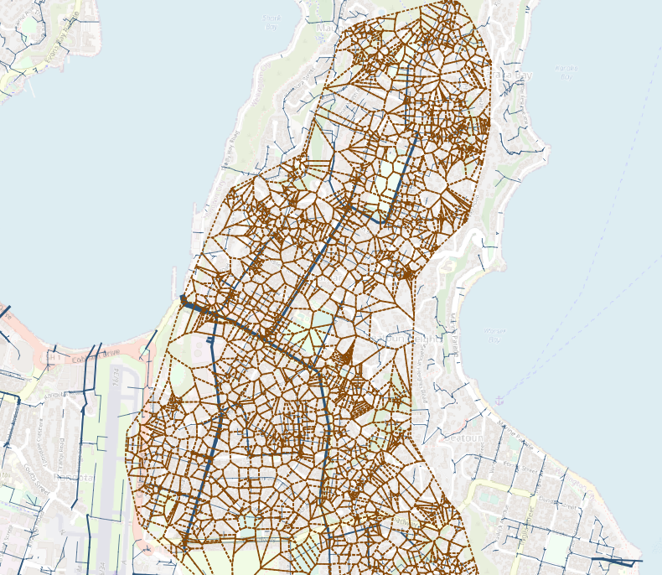
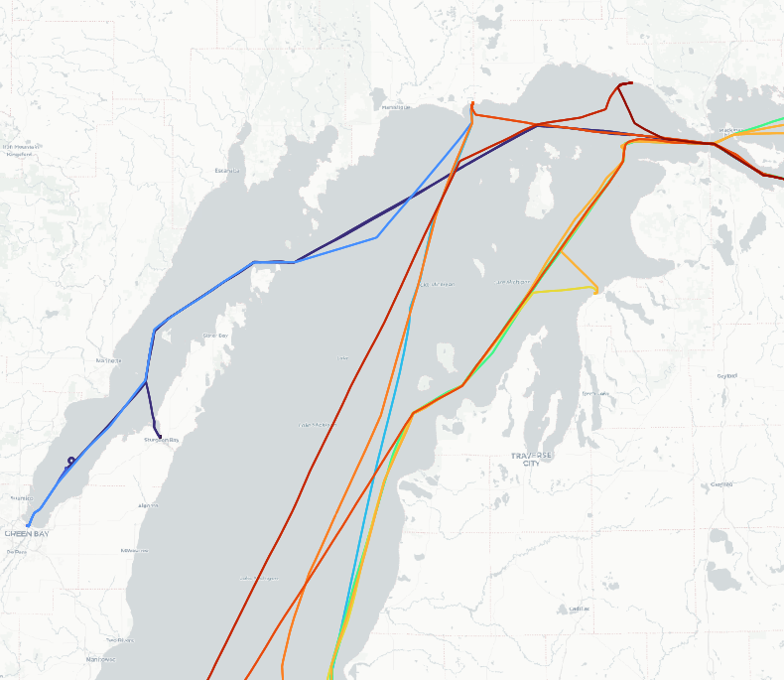
SAP HANA Cloud Multi-Model Spatial Use Case Patterns
Spatial Clustering
Detect spatial relationships
Customers in sales region
Spatial aggregation
Density and distribution along spatial grids
Catchment areas of hospitals
Calculating trajectories and motion statistics
Deriving routes, speed, and dwell location from location observations
Spatial machine learning
Geospatial features for use in classification algorithms
Spatial clustering for location based timeseries forecast
Catchment Areas
Trajectories
Geospatial Features

Slide 7





SAP HANA Cloud Multi-Model Graph Core Capabilities
Graph model
Labeled property graph embedded into SQL/relational
Graph queries and algorithms
Cypher for pattern matching
Built-in algorithms, e.g. shortest path, page rank, link prediction
In-database Graph procedures (“GraphScript”)
Consumption
SQL, ABAP (via AMDP)
Python client for machine learning (hana-ml)
HANA Database Explorer, Cytoscape (preview)
Roadmap milestones
Massive performance improvements for real-time updates
Graph on JSON Document Store, improved handling of heterogenous data
Python Environment
Python ML API
Applications
Augmented Processes
SAP HANA
Pattern
Matching
Network Analysis Procedures
Graph Model
Relational Store

Slide 8
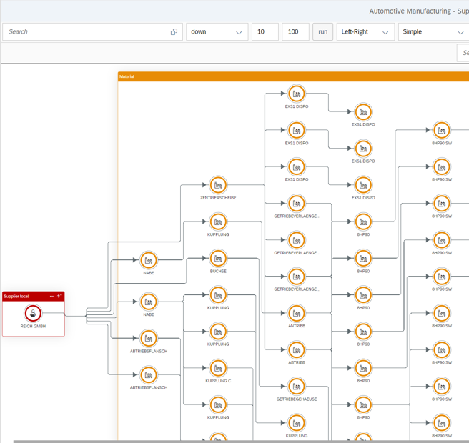
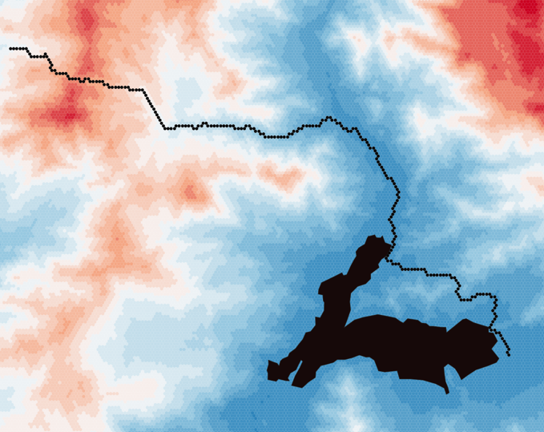
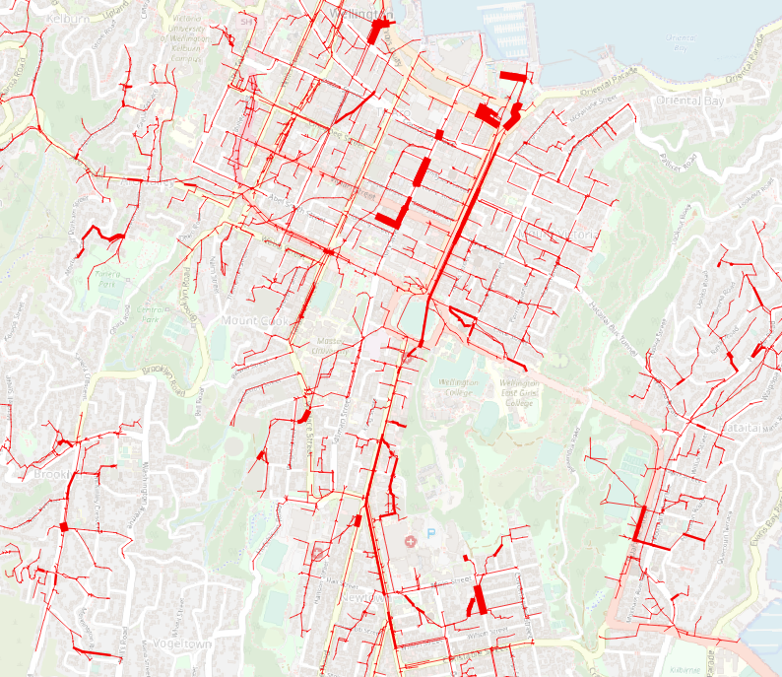
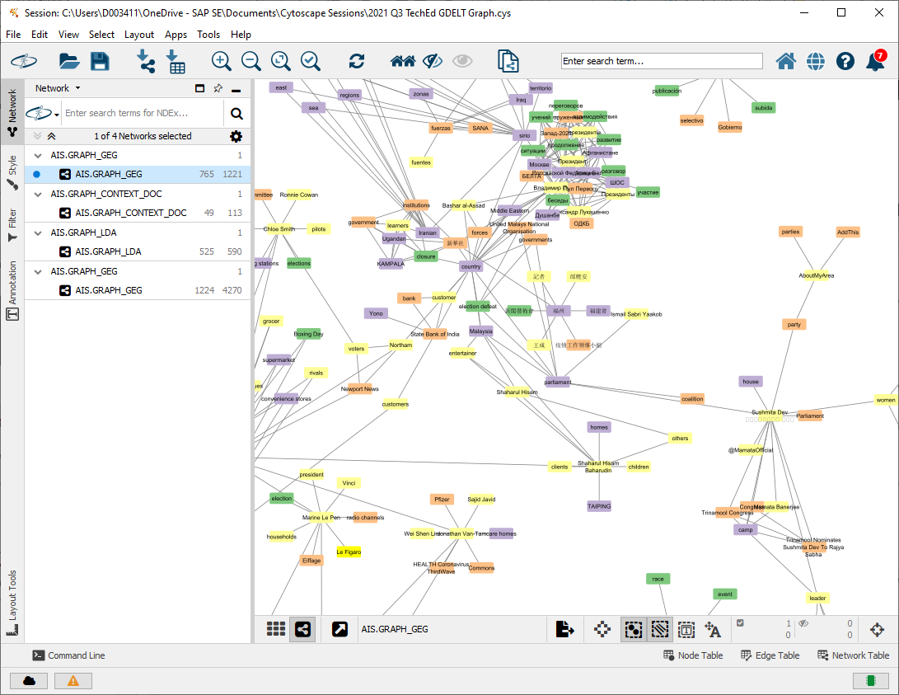
SAP HANA Cloud Multi-Model Graph Use Case Patterns
BOM Dependencies
Identifying dependencies
BOM explosion and where used list
Infrastructure outages
Reachability, paths, isochrones
Pathfinding in open terrain
Business-specific routing with custom cost function
Cycle detection, topological sorting
Sort production data for costing runs
Flow analysis
Financial fraud, utilities
Centrality
Find “important” nodes in a transportation network
Graph machine learning
Graph features for use in classification algorithms
Pathfinding
Flow Analysis
Node Classification

Slide 9
SAP HANA Cloud Multi-Model Graph Model
employs
GRAPH WORKSPACE describes a directed, labeled property graph
Vertices
Edges
Data source
Tables
Views
Table Functions
Fred
SAP
works for
GRAPH WORKSPACE org_graph EDGE TABLE edges SOURCE COLUMN src TARGET COLUMN trg KEY COLUMN id VERTEX TABLE vertices KEY COLUMN id
ID | NAME | TYPE
1 | Fred | Person
2 | SAP | Organization
SRC | TRG | TYPE
1 | 2 | works for
2 | 1 | employs

Slide 10
SAP HANA Cloud Multi-Model Graph Pattern Matching
SAP HANA Graph supports a subset of open Cypher for pattern matching queries
MATCH (p:Person) - [e: works for] -> (o:Organization)
WHERE p.ID = 1
RETURN p.NAME AS Pers, o.NAME AS Org
Pattern matching queries are wrapped in a SQL Table Function
SELECT * FROM OPENCYPHER_TABLE (
GRAPH WORKSPACE org_graph
QUERY ' MATCH … WHERE … RETURN …'
);
Fred
SAP
works for

Slide 11
SAP HANA Cloud Multi-Model Graph Built-In Algorithms and Graph Procedures
SAP HANA Graph provides a graph specific programming model “GraphScript”
graph, vertex, edge, path, multiset, sequence, map
Basic operations, e.g.
DEGREE(vertex), IN_EDGES(vertex)
SOURCE(edge)
WEIGHT(path), EDGES(path)
Graph algorithms , e.g.
REACHABLE_VERTICES(vertex), NEIGHBORS(vertex)
SHORTEST_PATH(source, target)
Traversal statements
BFS (breadth first search)
DFS (depth first search)
Dijkstra
Imperative logic implemented in “GraphScript” is executed in the database
Procedures
Table Functions
Anonymous blocks

Slide 12
SAP HANA Cloud Multi-Model GraphScript Example
CREATE FUNCTION “F_SPOO_PATHS” (
IN i_source BIGINT,
IN i_target BIGINT
)
RETURNS TABLE ("ORD" BIGINT, "EDGE_ID" NVARCHAR(5000), "length" DOUBLE)
LANGUAGE GRAPH READS SQL DATA AS
BEGIN
GRAPH g = Graph("GRAPH_WORKSPACE");
VERTEX v_source = Vertex(:g, :i_source);
VERTEX v_target = Vertex(:g, :i_target);
WEIGHTEDPATH<DOUBLE> p =
Shortest_Path(:g, :v_source, :v_target, (Edge e) => DOUBLE{ return :e."length"; }, 'ANY');
RETURN SELECT :ord, :e."EDGE_ID", :e."length" FOREACH e IN Edges(:p) WITH ORDINALITY AS ord;
END;

Slide 13
SAP HANA Cloud Multi-Model Graph Architecture
SAP HANA Cloud
SQL (query, function, procedure)
Open Cypher
Graph Script
Relation Operations (text, spatial, …)
Pattern Matching
Graph Algorithms
Graph Workspace
Vertices
Edges

Slide 14
SAP HANA Cloud Multi-Model Further Information
SAP HANA Spatial Resources https://blogs.sap.com/2020/11/02/sap-hana-spatial-resources-reloaded/
SAP HANA Graph Resources https://blogs.sap.com/2021/07/21/sap-hana-graph-resources/
SAP HANA Graph Cheat Sheet https://help.sap.com/docs/HANA_CLOUD_DATABASE/11afa2e60a5f4192a381df30f94863f9/53f791d0d2ce47918591aa3d929d693e.html
Spatial and Graph Blog Posts https://blogs.sap.com/tags/de9a1528-5ec2-4e53-8fd1-65f670054c68/ https://blogs.sap.com/tags/f7ceb1c1-a340-4b92-b8fb-c92b7a81e921/
Questions? https://answers.sap.com/index.html use tags “SAP HANA Spatial”, “SAP HANA Graph”
Multi-Model Community Page https://community.sap.com/topics/hana/smart-multi-model

Slide 15

Community Challenge: SAP HANA Graph

Slide 16
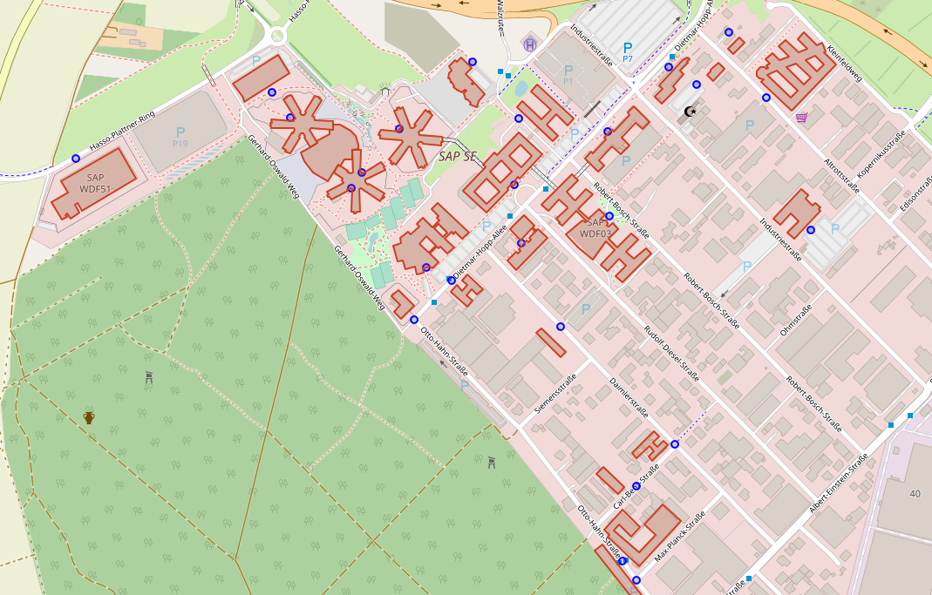
SAP HANA Cloud Multi-Model Graph Challenge
WDF 53
WDF 13

Slide 17
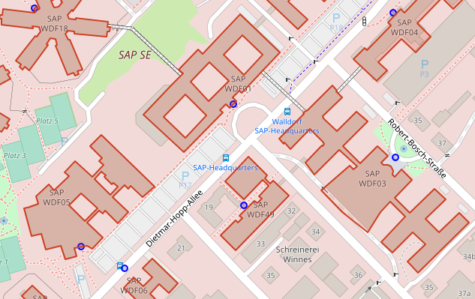
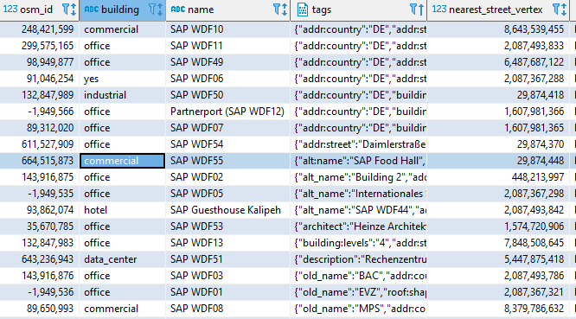
SAP HANA Cloud Multi-Model Graph Challenge
You work in WDF 53, and your friend works in WDF 13. You haven’t seen each other in a while and want to meet over coffee. Having busy schedules, you want to avoid that one must walk all the way while other one can just stay in their building. Find an SAP building “in between”, so both of you need to walk a minimal distance
Each building is connected to the street network via its “nearest_street_vertex”
Find a path to any other building from WDF53 and WDF13 respectively, where you can meet (office, commercial, yes)

Slide 18
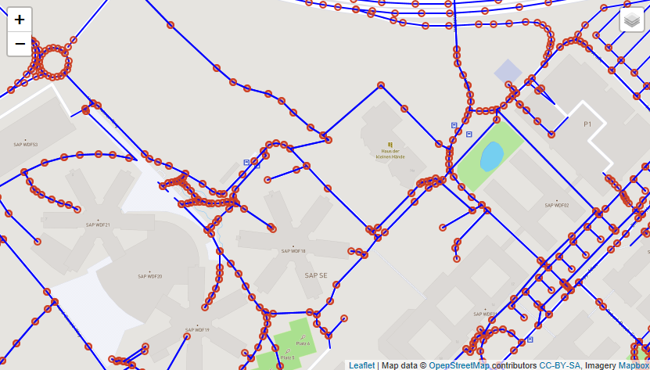
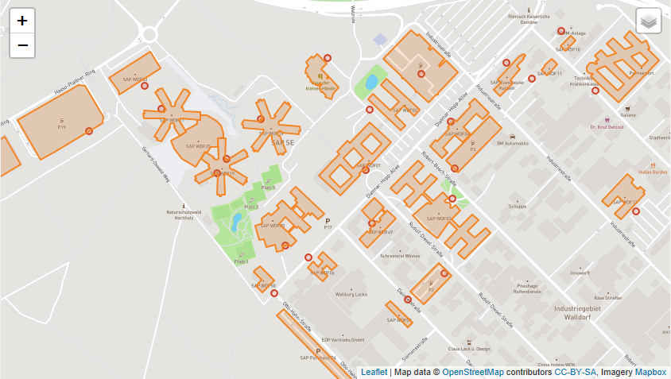
SAP HANA Cloud Multi-Model Graph Challenge
OSM street network
Table SAPWDF_EDGES
Street segments (directed edges)
Linestrings, length
u, v (source, target vertex)
Table SAPWDF_VERTICES
Junctions (vertices)
Points
SAP Buildings
Table SAP_WDF_CAMPUS
Polygons, nearest street vertex
Link GitHub repository

Slide 19
DEMO

Slide 20
Thank You.
SAP Community: https://community.sap.com/
SAP Community Topic Pages link: https://community.sap.com/topics/hana
SAP Community Q&A Tags: "SAP HANA": https://blogs.sap.com/tags/73554900100700002181/ "SAP HANA studio": https://blogs.sap.com/tags/67838200100800004076/ "SAP HANA, platform edition": https://blogs.sap.com/tags/01200314690800001945/ "SAP HANA Cloud": https://blogs.sap.com/tags/73554900100800002881/
Follow us in SAP Community: Markus Fath: https://people.sap.com/markus.fath Umang Rawat: https://people.sap.com/rawatu

